Slide 1


SKYSCHEDULE – AIRPORT FLIGHT BOARD & SCHEDULER
Team Members
Member 1: 2600080107 - MADASU POOJITH
Member 2: 2600080245 - RASINANI YETHISH
Member 3: 2600080256 - ODISI DILIP KUMAR
Member 4: GOWTHAM NUKALA
Course: 26SC1101 Java Programming
Dept: BES-1, KL University | 2026-27
S K Y
Faculty Mentor
Dr. D. Anand

Slide 2






Technologies & Concepts Used
Development Stack
Core Java Concepts
Data Structures & Processing
Language: Java (JDK)
Classes, Objects, Encapsulation
Object arrays (100 records)
Platform: Console
Inheritance and
Polymorphism
Searching and Grouping
IDE: Eclipse IDE
OS: Windows 10+
Validation and
Report Generation
Exception Handling
File Handling

Slide 3
1. Project Overview
SkySchedule organizes airport flight-board and scheduling activities in one system.
Problem Statement
Project Objectives
• Airport operations link flights, passengers, gates and bookings, which are hard to track by hand.
• Unorganized records make it difficult to retrieve, review and update information consistently.
• Staff need one validated, searchable application with updates and summary reports.
• Maintain flight, airline and passenger records.
• Manage flight schedules and gate allocation.
• Create and manage booking information.
• Validate data and support searching.
• Generate operational reports and simple airport analysis.

Slide 4
2. Functional Modules
The ten modules of SkySchedule, grouped by purpose.
Core Records
Operations
• Flight Module
• Airline Module
• Passenger Module
• Gate & Schedule Module
• Booking Module
• Gate allocation and schedule updates
Support Services
Insights & Control
• ValidateService: input checks
• SearchService: record lookup
• Fewer invalid or inconsistent records
• ReportGenerationService
• AnalysisService
• Main Module (menu)

Slide 5
3. SDLC Approach for SkySchedule
How SkySchedule was planned, built, tested and maintained.
01
Planning
02
Requirements
03
System Design
Define scope: flight board, scheduling, booking and airport analysis.
Capture flight, airline, passenger, schedule, booking and report needs.
Draw the data flow diagram and algorithm; plan ten Java classes.
04
Implementation
05
Testing
06
Deployment & Maintenance
Code ten modules in Eclipse using OOP, arrays and file handling.
Test each module’s output, then integrate through the Main menu.
Run on JDK; extend with a database, online booking and a mobile app.

Slide 6
4. Requirements Analysis
Functional requirements derived from the SkySchedule modules.
Functional Requirements
Quality and Validation Needs
• Flight: add, update and display flights (ID, number, source, destination).
• Airline: add, update and display airlines (ID, name, contact, headquarters).
• Passenger: register, update and display (ID, name, passport, mobile).
• Schedule: allocate gate, update schedule and change gate.
• Booking: book ticket, allocate seat and cancel booking.
• Validate flights, airlines, passengers and bookings before saving.
• A booking needs an existing passenger ID and flight ID.
• Search flights, airlines, passengers and bookings.
• Reports and analysis: destinations, passenger count, busy routes, summary.
• Save the flight report to SkyScheduleReport.txt.

Slide 7
5. System Architecture / Data Flow
High-level flow of SkySchedule; the Main module calls every other module.
Menu input
Output / reports
SKYSCHEDULE MAIN MODULE
USER
REPORTS
Flight
Airline & Passenger
Gate & Schedule
Booking
Search & Validate
Reports & Analysis
Arrays: flights • airlines • passengers • schedules • bookings (100 each)

Slide 8
6. Data Flow Diagram
Menu-driven flow of SkySchedule (from the project report).
Start
Read choice
Display menu
Choice = 11?
Yes: print thank you
Stop
Menu options 1–10: each choice calls a module method, then returns to the menu
1. Add Flight
addFlight()
2. Display Flights
displayFlight()
3. Add Airline
addAirline()
4. Display Airlines
displayAirline()
5. Register Passenger
registerPassenger()
6. Display Passengers
displayPassenger()
7. Add Schedule
addSchedule()
8. Display Schedules
displaySchedule()
9. Book Ticket
bookTicket()
10. Display Bookings
displayBooking()
No: any other choice returns to the menu.

Slide 9
7. Data Storage and Key Operations
Records are held in object arrays; the flight report is saved to a text file.
Module
Data stored
Key operations
Flight
flightId, flightNumber, source, destination
addFlight / updateFlight / displayFlight
Airline
airlineId, name, contactNumber, headquarters
addAirline / updateAirline / displayAirline
Passenger
passengerId, name, passportNumber, mobileNumber
registerPassenger / update / display
Schedule
scheduleId, flightId, gateNumber, departure, arrival
allocateGate / updateSchedule / changeGate
Booking
bookingId, passengerId, flightId, seat, status
bookTicket / allocateSeat / cancelBooking
Records live in arrays during a run; saveFlightReport() writes SkyScheduleReport.txt.

Slide 10
8. Testing Strategy
Selected test runs of SkySchedule modules (screenshots on the output slides).
Flight
Flight 123, no. 12, Japan to India; update
Added, displayed and updated to Kerala
Airline
Airline 1 “KL”, contact 1547896, India
Added and displayed successfully
Passenger
Passenger 1222, passport 455, mobile 147
Registered and displayed successfully
Schedule
Schedule 12, gate 12, 1:20 to 1:30
Allocated and displayed successfully
Booking
Booking 12, passenger 1, flight 1
Ticket booked; seat not allocated; Booked
Validation
Flight and passenger entries
“Flight / Passenger Details Valid!”

Slide 11
9. Outcomes and Future Enhancements
Results of the SkySchedule project and planned extensions.
Outcomes Achieved
Possible Future Enhancements
• Simple, easy-to-understand airport flight management system.
• Less manual work in managing flight, passenger, booking and schedule data.
• Ten modules working together through one Main menu.
• Validation, searching, reports and airport analysis on demand.
• Flight report saved to a text file.
• Database connectivity.
• Online booking.
• Real-time flight updates.
• Mobile application.
• Secure user login.

Slide 12
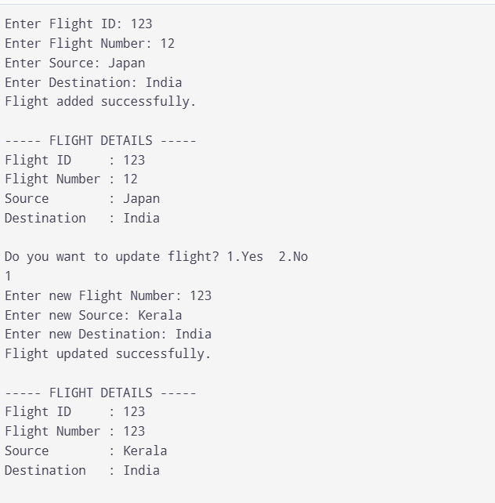
Output 1 – Flight Module: add flight, display, update flight

Slide 13
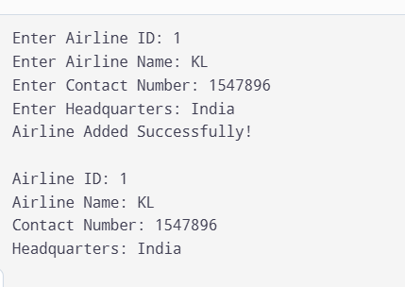
Output 2 – Airline Module: add airline and display details

Slide 14
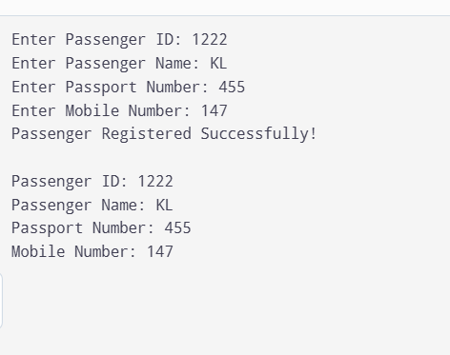
Output 3 – Passenger Module: register passenger and display details

Slide 15
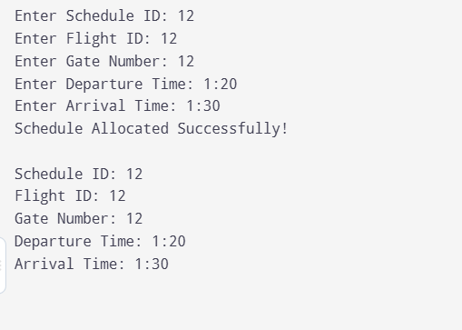
Output 4 – Gate & Schedule Module: allocate schedule and display

Slide 16
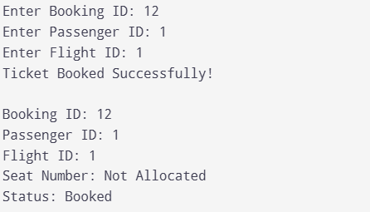
Output 5 – Booking Module: book ticket, booking ID and status

Slide 17
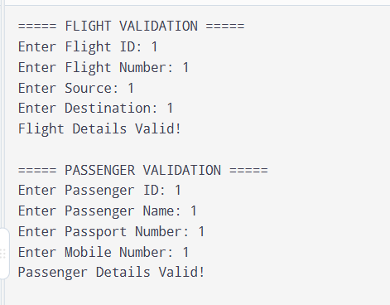
Output 6 – ValidateService: flight and passenger validation

Slide 18
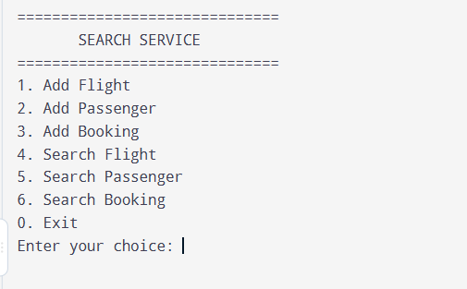
Output 7 – SearchService: search menu

Slide 19
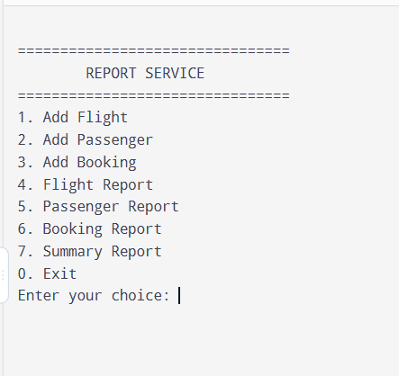
Output 8 – ReportGenerationService: report menu

Slide 20
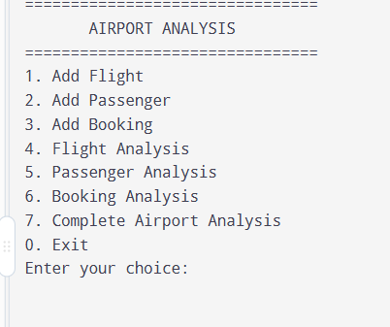
Output 9 – AnalysisService: airport analysis menu

Slide 21
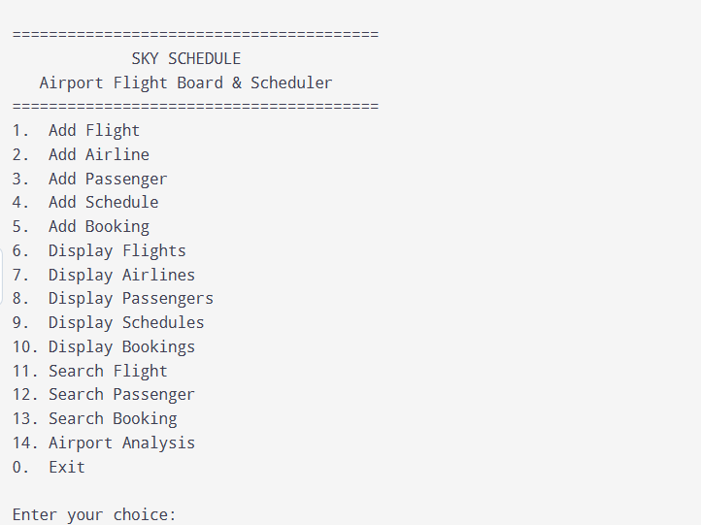
Output 10 – Main Module: SkySchedule main menu

Slide 22


THANK YOU
SKYSCHEDULE – AIRPORT FLIGHT BOARD & SCHEDULER
Questions & Answers

